Slide 1
Receipt and Invoice Digitizer
Milestone – 1
P. Pranitha

Slide 2
Problem Statement
Businesses and individuals still rely heavily on paper-based receipts and invoices.
Physical receipts are easily lost, damaged, or faded over time.
Manual data entry from receipts is time-consuming and error-prone.
Managing large volumes of receipts makes tracking expenses difficult.
Lack of digitization prevents quick search, analysis, and reporting.
Traditional systems do not provide automated insights or spending analytics.
Integration with accounting or ERP systems is difficult without structured data.

Slide 3
Implementation Details
Implemented a file upload interface to accept receipt images and PDFs (PNG, JPG, JPEG, PDF).
Performed image preprocessing (grayscale conversion, noise removal, binarization) to improve OCR accuracy.
Integrated OCR engine to extract raw text from uploaded receipts.
Supported both image-based and PDF-based documents.
Displayed original and processed images for visual verification.
Stored extracted text temporarily for further processing in later milestones

Slide 4
Outcome of Milestone 1
Successfully digitized receipt content from physical documents.
Established a reliable OCR pipeline for text extraction.
Created a strong base for AI-based field extraction and analytics in future milestones.

Slide 5
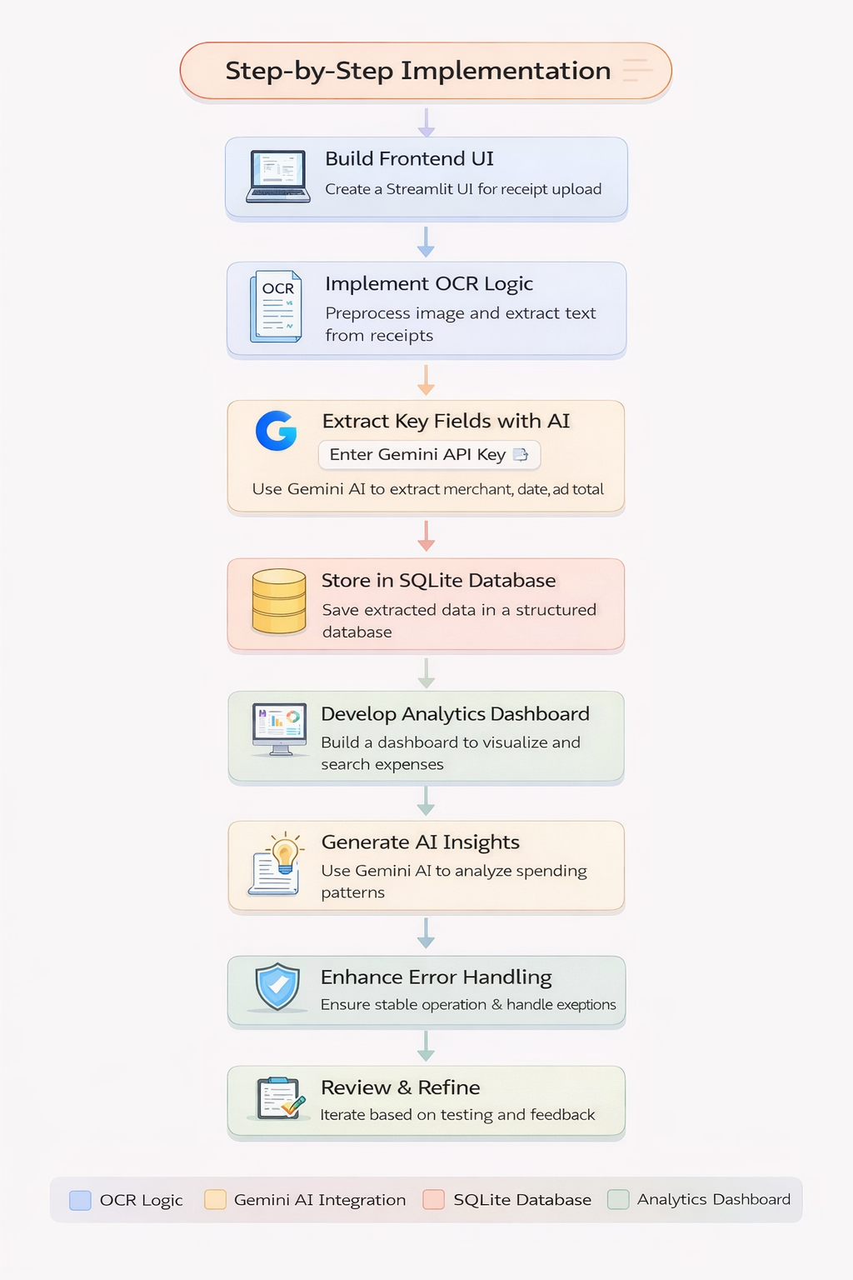
Technologies Used Python – Backend processing and logic Streamlit – Web-based user interface Tesseract OCR – Text extraction from receipts Image Processing (OpenCV/PIL) – Image enhancement SQLite – Temporary structured data storage
Methodology
User uploads receipt images or PDF files through the web interface.
Uploaded documents are converted into OCR-compatible images.
Image preprocessing is applied to improve text clarity.
OCR extracts raw text from the processed receipt.
Extracted text is displayed for validation.
Digitized data is prepared for storage and analytics in later stages.

Slide 6
Impacts
Reduces dependency on manual receipt handling.
Minimizes human errors in data entry.
Enables faster digitization of receipts and invoices.
Improves accuracy of extracted financial data.
Provides a foundation for data-driven financial insights.
Benifits
Saves time and effort for businesses and individuals.
Prevents loss of important financial documents.
Enables easy search and retrieval of receipts.
Supports expense tracking and analysis.
Can be integrated with accounting and ERP systems.
Scalable solution suitable for small to large organizations.

Slide 7
THANK YOU

Slide 8
MILESTONE-2
Field Extraction & Validation

Slide 9
Implementation Details
Invoice images are captured and processed using OCR to extract raw text data.
Regex and NLP techniques are applied to parse and extract key invoice fields.
Business validation rules verify totals, tax values, and required fields.
Duplicate invoices are detected using invoice number, vendor, date, and amount.
Validated and duplicate-flagged records are stored as structured data in the database.

Slide 10
Outcomes of Milestone 2
Accurate extraction of key invoice fields from images and PDFs.
Conversion of unstructured invoice text into structured data.
Validation of totals, tax values, and mandatory fields to ensure data correctness.
Detection and flagging of duplicate invoices to avoid redundancy.
Reliable storage of clean, validated invoice data for further processing.

Slide 11
Technologies and Methodology – Milestone 2 Technologies Used Python – Core programming language for processing and validation logic. OCR Engine (Tesseract / similar) – Extracts text from invoice images and PDFs. Regex – Identifies structured patterns like invoice number, date, and totals. NLP Techniques – Extracts contextual fields such as vendor name and line items. Database (SQL / NoSQL) – Stores validated and duplicate-flagged invoice data.
Methodology Followed
Invoice images are captured and converted into text using OCR.
Extracted text is parsed using Regex and NLP techniques.
Key invoice fields are identified and normalized.
Business validation rules verify financial correctness.
Clean and validated data is stored for further processing.

Slide 12
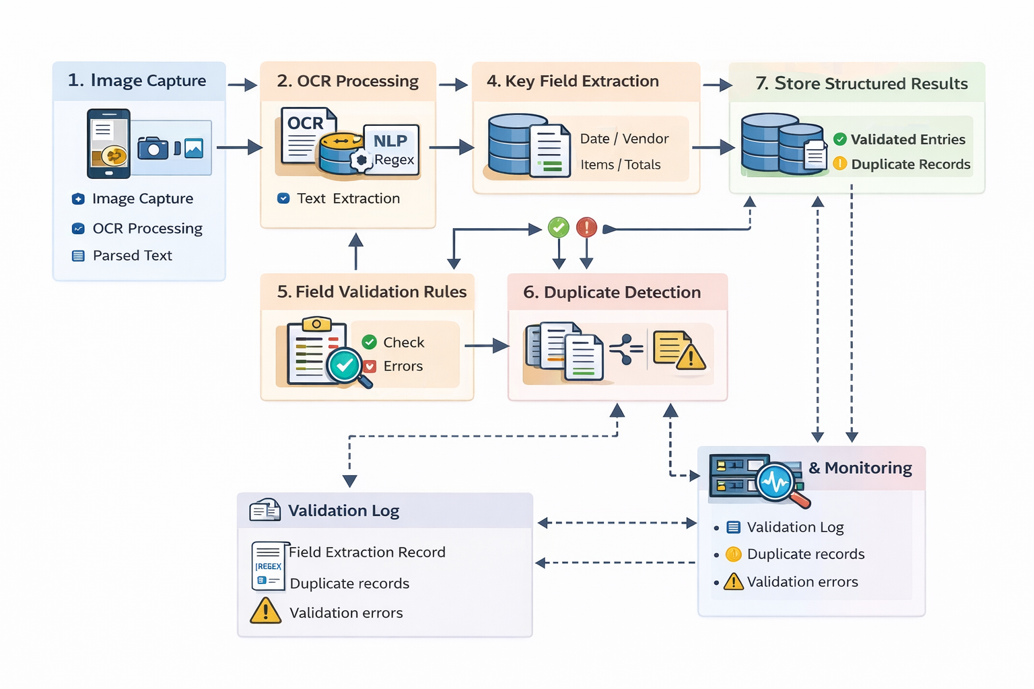
Architecture – Milestone 2

Slide 13
The system follows a modular pipeline architecture for invoice processing. Invoice images or PDFs are captured and sent to the OCR module for text extraction. Extracted text is processed using NLP and Regex modules to identify key fields. Validation and duplicate detection layers ensure data accuracy and consistency. Validated structured data is stored in the database with logging and monitoring support.

Slide 14
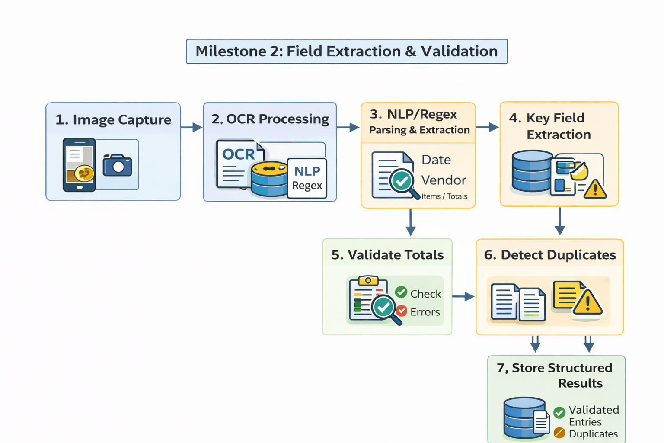
Flow chart

Slide 15
Flow Chart Explanation – Milestone 2 The process begins with capturing or uploading an invoice image or PDF. The uploaded file is processed using OCR to convert the image into text. NLP and Regex techniques analyze the extracted text to identify key invoice fields. Validation rules check the accuracy of totals, tax values, and required fields. Duplicate invoices are detected, and validated data is stored in the database.

Slide 16
Conclusion – Milestone 2 Milestone 2 successfully implements the extraction and validation of invoice data using OCR, NLP, and Regex techniques. The system converts unstructured invoice images into accurate, structured data while ensuring correctness through validation rules and duplicate detection. This milestone establishes a reliable foundation for secure data storage and enables further automation and analytics in subsequent milestones.

Slide 17
Thank you

